Slide 1


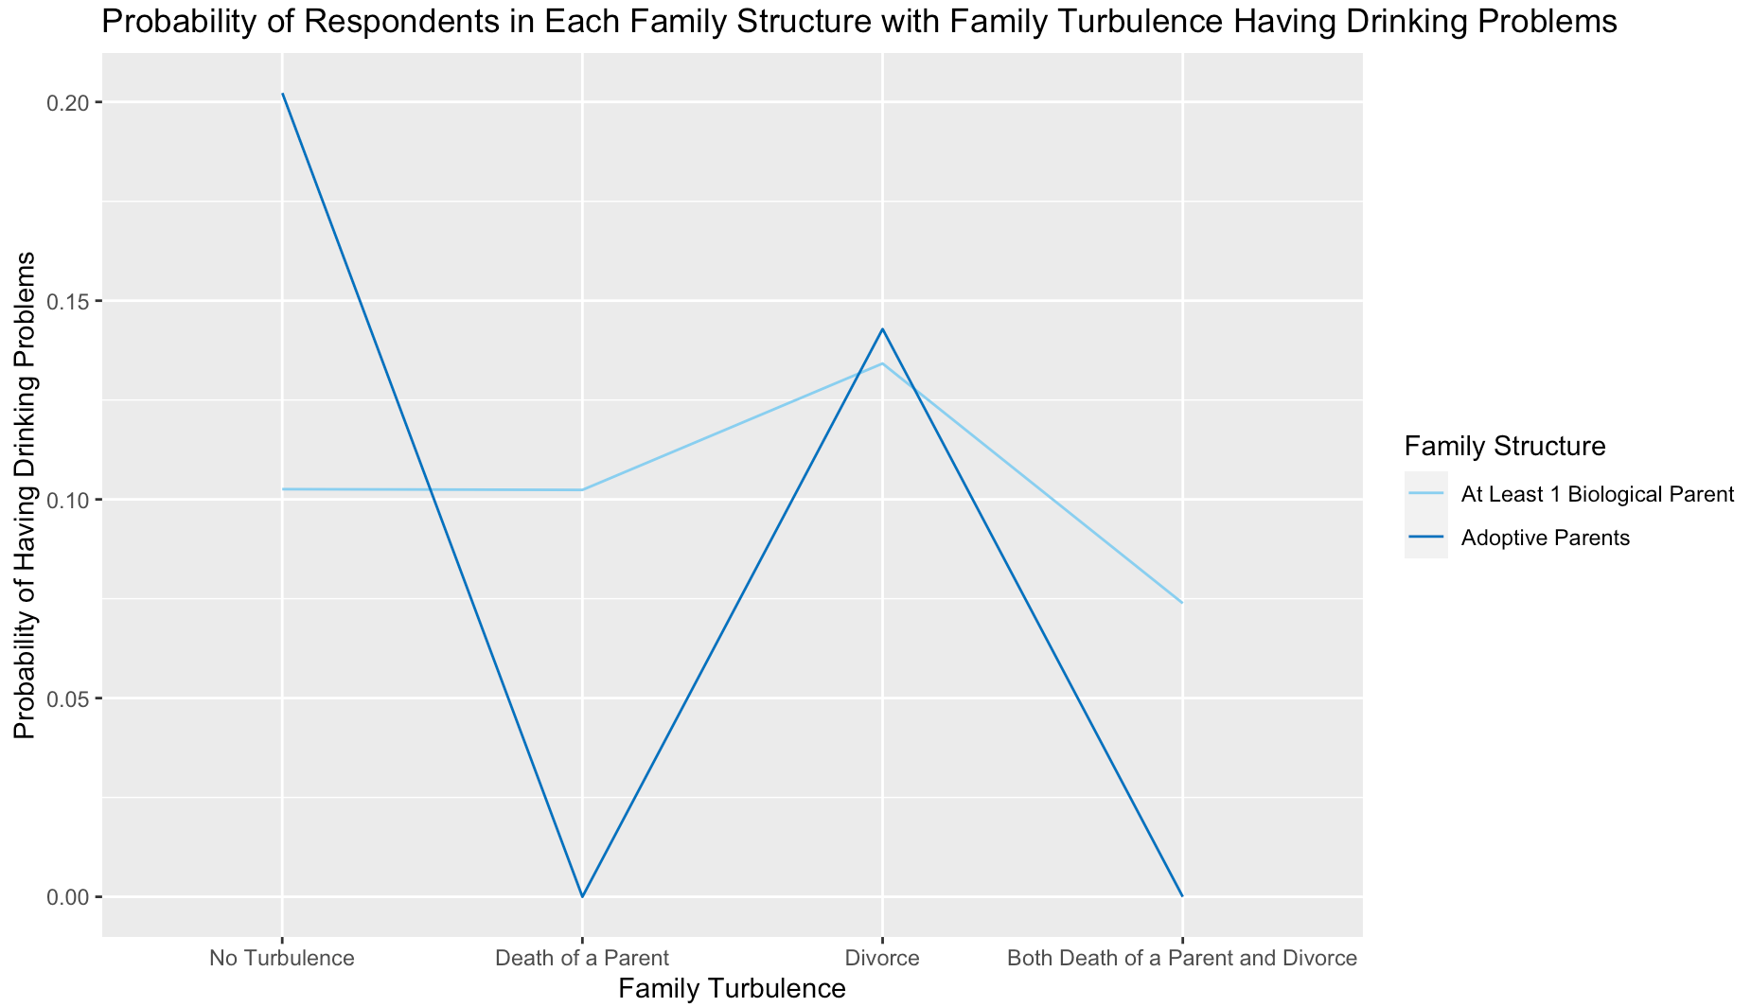
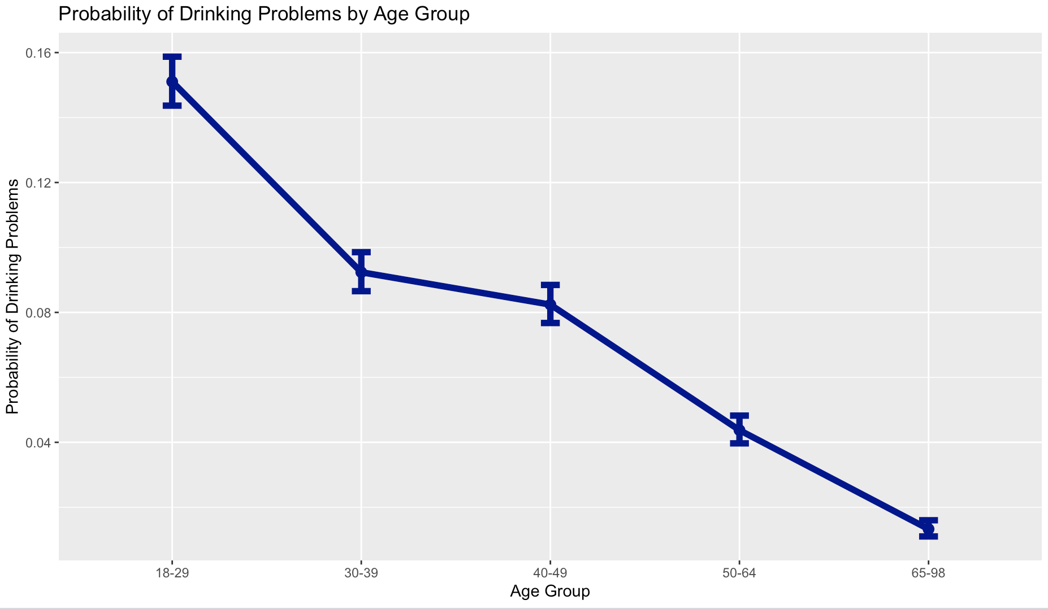
Investigating the Relationship Between Pre-Assessed Risk Levels, Criminal Thinking Profiles, and Post-prison Outcomes
Caleb Henning, Wesleyan University
Introduction
Methods
Bullet point about risk levels and ORAS
Bullet point about demographic factors and how they influence post-prison outcomes
Bullet point about criminal thinking profile/any relevant research along those lines and how they influence post-prison outcomes
This capstone aims to investigate the relationship between pre-assessed risk levels, criminal thinking profiles, demographic variables, and post-prison outcomes. Additionally, this project will delve more specifically into how these relationships are moderated by the program type and location each prisoner is placed into for rehabilitation after their sentence is over.
Sample
Data were collected from seven different datasets (N=1129), including information on demographics, which programs they were in and how long, criminal thinking profile scores, pre-assessed risk levels, and suicide and homicide risk.
Measures
Risk level variable and scoring
CTP and scoring
Outcomes and scoring
Demographics, program names, suicide/homicide risk, length of stay, etc.
Research Questions
What factors influence successful and unsuccessful outcomes for people in rehabilitation programs at the Connection?
Results
Discussion
Univariate
27% of young adults between 25 and 35 who experienced divorce during childhood developed problems with alcohol abuse and/or dependence.
A much lower proportion of young adults in this age range had unorthodox family structures, with 2% being adopted and 0.9% in other situations.
Individuals raised by adoptive parents are more at risk for developing later in life alcohol abuse and/or dependence.
Individuals experiencing parental divorce are also more at at risk for developing later in life alcohol abuse and/or dependence.
Younger individuals in general are significantly more at risk for developing alcohol abuse and/or dependence.
Interestingly, other factors also seem to be related to later in life alcohol abuse and/or dependence, including sex and region. Research does not support the findings about those in the Midwest being most at risk (Sacks et al., 2013). Research does support men being historically more at risk for drinking problems and less willing to get help for them (Grant, 1997; Timko et al., 2005).
Those raised in unorthodox family situations and/or those experiencing family turbulence during childhood need more support during adolescence to prevent developing drinking problems.
Bivariate
Chi-Square analysis showed that young adults who experienced family turbulence were more likely to develop drinking problems than those who did not (X²=14.59, 3 df, p=0.002). Pearson residuals revealed that those who experienced divorce are especially more likely to develop drinking problems than those who experienced no turbulence (p=0.006).
Chi-Square analysis also showed an association between family structure and developing drinking problems (X²=12.41, 2 df, p<0.0002). Pearson residuals revealed that those who were raised in other family structures (p<0.02) are especially more likely to develop drinking problems.
Figure 1. Probability of Respondents in Each Family Structure with Family Turbulence Having Drinking Problems
Multivariate (cont.)
Those raised by adoptive parents have an expected odds of drinking problems that is 1.94 times higher than those raised by at least one biological parent holding age, sex, region and family turbulence fixed.
Those who experienced divorce during childhood have an expected odds of drinking problems that is 1.43 times higher than those raised by at least one biological parent holding age, sex, region and family structure fixed.
Age also appears to influence drinking problems as respondents who are within the 18-29 age group having a probability of 0.15, which drops down to 0.09 in the 30-39 age group, holding all other variables fixed (Figure 2).
Multivariate
Both family turbulence and family structure influence later in life drinking problems, but underrepresentation of adopted children has led to difficulty in interpreting how much of a difference turbulence makes for them. However, adopted children are more at risk for drinking problems even if they don’t experience turbulence, emphasizing the importance of family structure (Figure 1).
It is also clear that those raised by at least one biological parent experience significant effects from family turbulence, specifically divorce, as their probability for drinking problems rises from 0.10 to 0.13 after experiencing divorce during childhood (Figure 1).
Askeland, K. G., Sivertsen, B., Skogen, J. C., La Greca, A. M., Tell, G. S.,
Aarø, L. E., & Hysing, M. (2018). Alcohol and drug use among
internationally adopted adolescents: Results from a Norwegian
population-based study. American Journal of Orthopsychiatry, 88(2),
225–235.
Balázs, M. Á., Piko, B. F., & Fitzpatrick, K. M. (2017). Youth problem
drinking: The role of parental and familial relationships. Substance Use
& Misuse, 52(12), 1538–1545.
https://doi.org/10.1080/10826084.2017.1281311
Cadoret, R. J., Troughton, E., O’Gorman, T. W., & Heywood, E. (1986). An
adoption study of genetic and environmental factors in drug abuse.
Archives of General Psychiatry, 43(12), 1131–1136.
https://doi.org/10.1001/archpsyc.1986.01800120017004
Grant, B. F. (1997). Prevalence and correlates of alcohol use and DSM-IV
alcohol dependence in the United States: Results of the National
Longitudinal Alcohol Epidemiologic Survey. Journal of Studies on Alcohol,
58(5), 464–473. https://doi.org/10.15288/jsa.1997.58.464
Hoffmann, J. P. (2017). Family structure and adolescent substance use:
An international perspective. Substance Use & Misuse, 52(13), 1667–
1683. https://doi.org/10.1080/10826084.2017.1305413.
Lee, M.-C., Huang, N., & Chen, C.-Y. (2020). Effects of childhood adversity
trajectories on mental health outcomes in late adolescence: The
buffering role of parenting practices in Taiwan. Child Abuse & Neglect,
109, 104705. https://doi.org/10.1016/j.chiabu.2020.104705
Sacks, J. J., Roeber, J., Bouchery, E. E., Gonzales, K., Chaloupka, F. J., &
Brewer, R. D. (2013). State costs of excessive alcohol consumption,
2006. American Journal of Preventive Medicine, 45(4), 474–485.
https://doi.org/10.1016/j.amepre.2013.06.004
Timko, C., Finney, J. W., & Moos, R. H. (2005). The 8-year course of
alcohol abuse: Gender differences in social context and coping.
Alcoholism: Clinical and Experimental Research, 29(4), 612–621.
https://doi.org/10.1097/01.ALC.0000158832.07705.22
Figure 2. Probability of Respondents in Each Age Group Having Drinking Problems

